Slide 1
RL Project
Recycling Robot

Slide 2
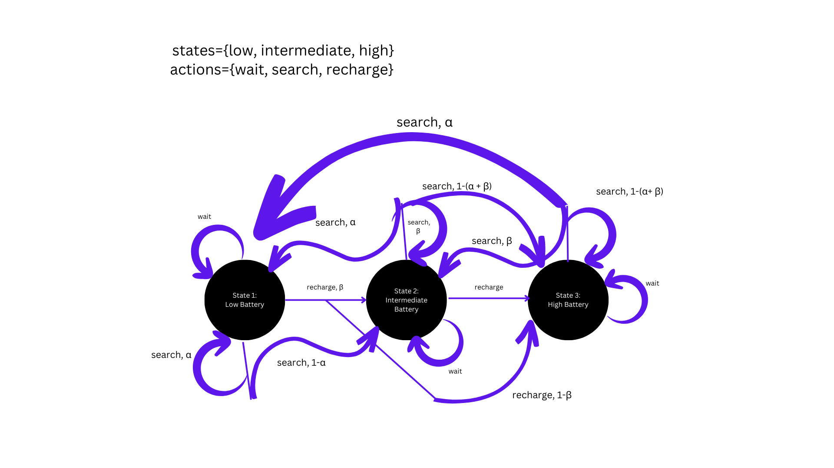

Slide 3
Q-Learning

Slide 4
Static Reward
Random Reward
REWARDS = {
'high': {'search': 2, 'wait': -1},
'intermediate': {'search': 0.1, 'wait': 1, 'recharge': 0.5},
'low': {'search': -2, 'wait': 0, 'recharge': 2}
}
REWARD_RANGE = {
'high': {'search': (1, 4), 'wait': (-3, 0)},
'intermediate': {'search': (0.5, 1.5), 'wait': (0, 3), 'recharge': (-3, -0.5)},
'low': {'search': (-4, -1), 'wait': (0, 3), 'recharge': (1, 4)}
}

Slide 5
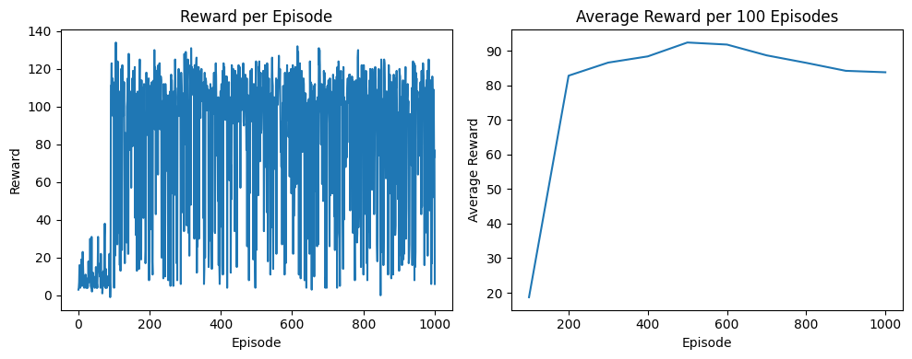
Static Reward

Slide 6
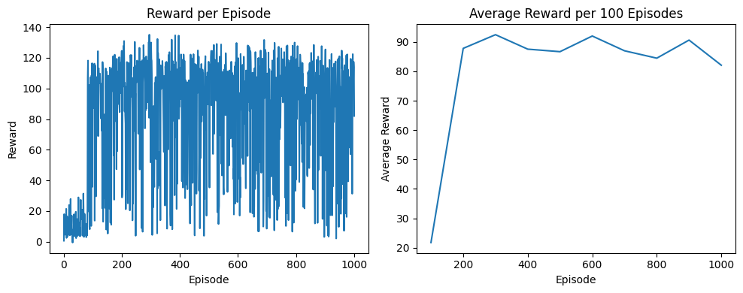
Random Reward

Slide 7
Parameters
set the probabilities for search and recharge
α = probability for low battery stage
β = probability for intermediate battery stage
γ = probability for high battery stage 1 - (α + β)
α + β + γ = 1

Slide 8
α = 0.6
β = 0.2
low: recharge
intermediate: recharge
high: search

Slide 9
α = 0.2
β = 0.6
low: recharge
intermediate: wait
high: search

Slide 10
α = 0.2
β = 0.2
low: recharge
intermediate: search
high: search

